Slide 1
Media and Information Literacy through Conflict Sensitive Education (MIL-CSE)
MODULE 2.1
Media and Information Literacy (MIL) & Conflict Sensitive Education (CSE) to Combat Conflict Triggering Hate Speech

Slide 2
Media and Information Literacy through Conflict Sensitive Education (MIL-CSE)
Module 1.1: Media and Information Literacy: Definition, Importance and Implementation Scenarios
Module 1.2: Conflict Sensitive Education: Definition, Importance and Competencies
Module 1.3.: The Relationship between MIL and CSE, and Their Position within the Teacher Competency Framework
Module 2.1.: MIL & CSE to Combat Conflict Triggering Hate Speech
Module 2.2.: MIL & CSE to Address Bias, Discrimination and Misrepresentation
Module 2.3: MIL and CSE to Combat Information Disorder
Module 3.1: MIL & CSE for Intercultural and Interreligious Dialogue
Module 3.2: MIL and CSE to Foster Cyber Safety and Security

Slide 3
Learning Objectives
At the completion of this module, participants will be able to:
Define hate and hate speech.
Describe the factors that lead to hate speech
Describe the various consequences of hate speech
Describe how Conflict Sensitive Education plays a great role in combating conflict triggering hate speech.
Apply learning activities that foster acceptance, mutual respect and tolerance.

Slide 4
Module Outcomes
Raised understanding of conflict triggering hate speech
Appreciation of the role of Conflict Sensitive Education in combating hate speech.
Developed competency and skill. to design teaching and learning activities that foster tolerance, acceptance, mutual respect, conflict resolution and collaboration.

Slide 5
Competencies
CSE 2: Identify biased learning content and materials in the curricula, including prejudiced or discriminatory information about individuals or groups and know how to remove or add activities to discuss the biases
CSE 4.4 Teacher supports students’ building, development and maintenance of healthy interpersonal relationships, cooperation and acceptance of differences
CSE 5: Teacher demonstrates awareness of ways to ensure Gender Equity, Disability and Social Inclusion in teaching and learning
CSE 6: Model and instruct on non-violence, critical thinking, peaceful conflict resolution and respect for different opinions
CSE 7: Understands the potential risks and can use traditional and modern teaching-learning tools (including media channels)

Slide 6
Competencies
CSE 8: Abides by principles of cultural sensitivity, authenticity, cultural identity, tolerance of differences (diversity), which are media and information literacy (MIL) core values
CSE 14: Demonstrate an understanding of the conflict dynamics and personal biases, and adapt instruction accordingly
CSE 15: Teacher has capacity to use contextually appropriate inclusive teaching methods and learning processes that support the learner’s well-being and learning
CSE 21: Understands the conflict, root causes and dynamics and the need for conflict transformation. Includes:
Possesses good inter-cultural sensitivity and understanding of learners and families
Able to have a conversation with learners about conflict
CSE 23: Teacher is aware of the basic nature and principles of Digital Citizenship
CSE 25: Involving parents and community members in the instruction and learning processes

Slide 7
PART I
Hate Speech: Its Definition, Characteristics and How to Combat it

Slide 8
What is hate?
Hate is an intense and irrational emotion of opprobrium, enmity, and detestation towards an individual or group.
Opprobrium = harsh criticism/ extreme dishonor (usually with long lasting consequences) / public disgrace
Enmity = the state or feeling of being actively opposed or hostile to someone or something.
Detestation= extreme hatred or dislike

Slide 9
What is hate speech?
Hate speech refers to any kind of communication in speech, writing or behavior, that attacks or uses discriminatory language with reference to a person or a group on the basis of who they are, i.e., based on their:
religion,
ethnicity,
nationality,
race,
color
descent
gender or
other identity factors
(Definition according to UN Strategy and Plan of Action on Hate Speech, May 2019).
These are called ‘Protected Characteristics’

Slide 10
What are the characteristics of ‘hate speech’?
Any communication in speech, writing or behavior is described as “Hate Speech”, if it features or evokes:
insensitivity,
strong feeling of resentment and hostility,
hateful discrimination,
intolerance, exclusion or segregation,
harmful stereotyping and prejudices,
Stigmatization,
imminent violence or
dehumanizing sentiments.
(Definition according to UN Strategy and Plan of Action on Hate Speech, May 2019).

Slide 11
Why are hate speeches considered a highly negative practice?
Hate speech are highly negative communication practices, because they reflect one of the following or a combination of the following:
Intolerance
Negative stereotyping
Stigmatization
Discrimination
Incitement to violence
Violence against persons based on religion or belief
Incitement of hatred
Spread of discrimination and prejudice
(Definition according to UN Strategy and Plan of Action on Hate Speech, May 2019).

Slide 12
What leads to hate speech?
Hate speech happens due to exclusionary thinking, prejudice, anger and, in some cases, a fear of “the other”. These patterns of thinking are learned. They are shaped by
political discourses
and social contexts which are embedded in power structures and are reinforced by
cultural contexts. systemic discrimination

Slide 13
How can hate speech trigger conflict ?
Hate speech can trigger conflict in several ways:
Escalation of Tensions: Hate speech often targets specific groups based on their race, religion, ethnicity, nationality, or other characteristics.
Normalization of Discrimination: When people hear hateful rhetoric regularly, they may become desensitized to it and more accepting of discriminatory attitudes and behaviors. This can lead to acts of discrimination or violence against targeted groups.
Mobilization of Extremist Groups: When hate speech is disseminated through social media, rallies, or other public platforms, it can attract individuals who share these extreme views and encourage them to take action, potentially leading to violence.
Polarization and Division: It can create an "us vs. them" mentality, making it harder for people from different backgrounds to find common ground and engage in constructive dialogue. This polarization can lead to conflicts between different groups.

Slide 14
How can hate speech trigger conflict ? (Cont.)
Undermining Social Cohesion: Hate speech undermines social cohesion by eroding trust and social bonds within a society.
Triggering Hate Crimes: When individuals or groups are exposed to hate speech that devalues and demonizes certain groups, it can motivate them to commit acts of violence against members of those groups.
Impact on Policy and Legislation: When policymakers or leaders engage in or tolerate hate speech, it can lead to the enactment of laws that discriminate against particular groups, further fueling conflict.
Suppressing Free Speech: Ironically, efforts to combat hate speech can sometimes lead to conflicts over free speech rights. When governments or organizations attempt to restrict or censor hate speech, it can trigger debates and protests, with some individuals arguing that their freedom of expression is being infringed upon.

Slide 15
What does research tell us about the prevalence of Facebook ‘hate speech’?
Phandeeyar conducted the study, “Hate Speech Lexicon”, from October 2019 to May 2020.
The study concluded that “hate speech is proliferating both online and offline in Myanmar.
In terms of prevalence, hate speech across Facebook comments can be categorized as follows:
COVID-19 (39.5%),
General (23.7%),
Ethnic Issues (20.4%),
Activism (7.1%),
Political Party (6.0%), and
Religion (3.3%).

Slide 16
How can we, as individuals and societies, combat hate speech?
There are three specific actions that we can undertake as individuals and societies to combat hate speech:
1- Develop Counter-narratives (based on facts, i.e., accurate and truthful) and fact-checking:
Fact-checking is a crucial tool for verifying the accuracy of information.
Fact-checkers, both individuals and organizations, assess claims made in public discourse and verify their truthfulness. This helps in debunking false narratives and preventing the spread of hate speech disguised as factual information.
Counter-narratives involve presenting alternative viewpoints or information that challenge the hate speech's false or discriminatory claims. These narratives should be based on accurate and truthful information.

Slide 17
How can we, as individuals and societies, combat hate speech? (Cont.)
2- Self-regulation through professional codes of ethics and standards:
Many professions, including journalism and broadcasting, have established codes of ethics and standards that require professionals to adhere to principles such as accuracy, fairness, and avoiding the promotion of hate speech. Self-regulation within these professions encourages responsible reporting and content creation.
Professionals who adhere to ethical guidelines promote tolerance, diversity, and factual reporting while discouraging the dissemination of hate speech.

Slide 18
How can we, as individuals and societies, combat hate speech? (cont.)
3- Develop Regulatory Mechanisms:
Legal and regulatory mechanisms play a crucial role in combating hate speech. Laws and regulations can define hate speech, set boundaries on its expression, and establish consequences for those who engage in it. Such regulations aim to strike a balance between free speech and the protection of individuals and communities from harm.
Social media platforms and online communities also have a role to play in regulating hate speech. They can enforce community guidelines and terms of service to remove or restrict hate speech content and users who repeatedly violate these guidelines.

Slide 19
How does MIL help combat hate speech?
Media and Information Literacy (MIL):
empowers individuals to critically assess and engage with media and information sources. By teaching MIL in educational settings, people can develop the skills needed to :
discern between reliable and unreliable sources of information,
recognize hate speech as well as discriminatory content, and
question the accuracy of content and/ or the intentions of the content and its creator.
helps individuals become more media-savvy, making them less susceptible to manipulation through hate speech and propaganda.
encourages people to seek diverse perspectives and consider multiple sources of information.

Slide 20
How can CSE help in combating hate speech?
Conflict Sensitive Education (CSE) :
CSE addresses the underlying factors that fuel hate speech which might be a trigger to conflict by promoting:
understanding,
critical thinking,
empathy, and
peaceful conflict resolution.
The CSE Areas of Focus (AoF):
Provide teachers with effective mitigation techniques and strategies.
Support the development of knowledge, attitudes and skills that favour open-mindedness, respect for human rights and an appreciation of diversity.
Ensure that those attitudes and skills are integrated into the wider institutional structure.
Ensure that learners embrace diversity providing support to anyone who is excluded or targeted.
Research has shown that well-integrated whole-school approaches have a more sustainable and positive impact than stand-alone programmes.
Instilling these values and skills in students creates a more tolerant and inclusive society where hate speech is less likely to take root and thrive.

Slide 21
Activity 1
Select from the below all correct statements
Hate speech----------
consists of only written messages, but not practices or behaviors that include some kind of discriminatory content.
refers to any kind of communication in speech, writing or behavior, that attacks or uses discriminatory language with reference to a person or a group on the basis of their protected characteristics.
refers to violent, hostile or discriminatory communication or behaviour that reflect intolerance, stigmatization, discrimination, and dehumanizing sentiments.
is featured by insensitivities, strong feeling of resentment and hostility, hateful discrimination and harmful stereotyping and prejudices.
could trigger conflict by eroding trust, undermining social cohesion and destroying social bonds.

Slide 22
Activity 2
Fill in the blanks using the suitable words
Race, gender, religion, nationality, color…. etc. are all considered to be ‘-------------------’.
pHate speech happens due to --------------------, prejudice, anger and, in some cases, a fear of “the other”.
Hate speech results of patterns of thinking that are shaped by---------------------, cultural and social contexts which are embedded in power structures and reinforced by systemic discrimination.
Actions that we can undertake as individuals and societies to combat hate speech include------------------------, developing counter-narrative, developing regulatory mechanisms, and self-regulation through professional -------------------and standards.
fact-checking
political discourses
protected characteristics
exclusionary thinking
codes of ethics
Introduction to Media and Information Literacy (MIL) for Mobile Teachers

Slide 23
Activity 3
Select from the below all correct statements
The implementation of CSE AoF within a classroom setting is important for the following reasons:
CSE AoF help to provide teachers with effective mitigation techniques and strategies.
The main aim of CSE AoF is to develop educators’ knowledge, attitudes, and skills that favor open-mindedness, respect for human rights and an appreciation of diversity.
The implementation of CSE AoF fosters the embracement of diversity and the provision of support to anyone who is excluded or targeted.
CSE addresses the underlying factors that fuel hate speech and which might be a trigger to conflict by promoting understanding, critical thinking, empathy, and peaceful conflict resolution.

Slide 24
Activity 4
Match between the terms in Column A and their respective definition in Column B
Hate | actions that deny equal treatment or opportunities to individuals or groups based on their membership in a particular category, such as race, gender, or religion.
Hate Speech | an inclination or preference for or against a particular person, group, or thing. It can be conscious or unconscious and may not necessarily result in discriminatory behavior
Prejudice | oversimplified and generalized beliefs about a particular group.
Bias | a tendency to prefer one person or thing to another, and to favor that person or thing.
Stereotypes | preconceived opinions or attitudes towards an individual or group, often based on stereotypes or incomplete information, that are not based on reason or actual experience.
Discrimination | any kind of communication in speech, writing or behavior, that attacks or uses discriminatory language with reference to a person or a group on the basis of protected characteristics.

Slide 25
Activity 5
Which of the following statements is true and which is false?
Statement | True | False
Hate speech is not harmful and would never trigger violence, hostility or conflict.
2) Race, gender, color, nationality, religion, sexual orientation…..etc. are all types and forms of ‘protected characteristics’
3) When individuals or groups are exposed to hate speech that devalues certain groups, they immediately refer to peaceful conflict resolution techniques.
4) When hate speech is disseminated through social media, rallies, or other public platforms, it can attract individuals who share these extreme views and encourage them to take action, potentially leading to violence.
5) CSE addresses the underlying factors that fuel hate speech by promoting understanding, critical thinking, empathy, and peaceful conflict resolution.
6) Hate speech can normalize discrimination and prejudice.

Slide 26
PART II
Implementation Scenarios

Slide 27
What can MTTs do to combat hate speech, bias and discrimination?
Here is a set of teaching strategies, if implemented effectively could combat hate speech:
Raise awareness of learners on the impact of hate, bias, and discrimination and develop their competencies in promoting peace, tolerance, and intercultural dialogue.
Integrate multiple perspectives into content and teaching practices to encourage speech to support diverse viewpoints and mutual understanding.
Promote media and information literacy and digital citizenship education to address hate speech online.
Organize student activities that promote collaboration among different ethnic or cultural groups.
Adopt classroom etiquette on how to deal with differences.
Organize food festivals to promote culinary arts among ethnic groups.
Encourage peer groups from different ethnic communities to discover their commonalities.
Introduction to Media and Information Literacy (MIL) for Mobile Teachers

Slide 28
Scenario 1: Integrate Multiple Perspectives
Activity:
Organize classroom debates or discussions on controversial topics related to hate speech and discrimination.
Assign students to research and present arguments from diverse viewpoints, even those they may not personally agree with.
Encourage respectful dialogue and critical thinking about different perspectives.
Final Outcome: More tolerant and open-minded classroom environment where students are better equipped to engage in constructive conversations about complex issues.
Implemented CSE AoF:
CSE 4.4: Teacher supports students’ building development and maintenance of healthy interpersonal relationships, cooperation and acceptance of differences.
CSE 6: Model and instruct on non-violence, critical thinking, peaceful conflict resolution and respect for different opinions.
CSE 8: Abides by principles of cultural sensitivity, authenticity, cultural identity, tolerance of differences (diversity) which are media and information literacy (MIL) core values.
CSE 14: Demonstrate an understanding of the conflict dynamics and personal biases and adapt instruction accordingly.
Introduction to Media and Information Literacy (MIL) for Mobile Teachers

Slide 29
Scenario 2: Promote Media and Information Literacy
Activity:
Provide students with examples of online hate speech and false information.
Teach them how to fact-check and critically analyze online content.
Have them create informative posters or videos that addresses responsible online behavior and share them with their peers.
Final Outcome: Students become proficient in recognizing and addressing online hate speech and misinformation.
Implemented CSE AoF:
CSE 7: Understands the potential risks and can use traditional and modern teaching-learning tools (including media channels)
CSE 8: Abides by principles of cultural sensitivity, authenticity, cultural identity, tolerance of differences (diversity) which are media and information literacy (MIL) core values.
CSE 23: Teacher is aware of the basic nature and principles of Digital Citizenship.
Introduction to Media and Information Literacy (MIL) for Mobile Teachers

Slide 30
Scenario 3: Organize Student Activities for Collaboration
Activity:
Assign students from different ethnic or cultural backgrounds to work together on a group project.
The project could involve problem-solving, research, or creative tasks that require collaboration.
Final Outcome: Students develop teamwork skills, form positive relationships, and gain a deeper understanding of their peers' perspectives. The final project showcases their ability to work harmoniously with individuals from diverse backgrounds.
Implemented CSE AoF:
CSE 4.4: Teacher supports students’ building development and maintenance of healthy interpersonal relationships, cooperation and acceptance of differences.
CSE 5: Teacher demonstrates awareness of ways to ensure Gender Equity, Disability and Social Inclusion in teaching and learning.
CSE 6: Model and instruct on non-violence, critical thinking, peaceful conflict resolution and respect for different opinions.
CSE21: Understands the conflict, root causes and dynamics and the need for conflict transformation which includes the possession of good inter-cultural sensitivities and understanding of learners and families.
Introduction to Media and Information Literacy (MIL) for Mobile Teachers

Slide 31
Scenario 4: Organize Food Festivals
Activity:
Students and their families prepare and share dishes from their respective cultural backgrounds at a multicultural food festival.
They may also create displays or presentations about the significance of their dishes.
Final Outcome: The promotion of cultural appreciation and unity as well as a sense of pride, a sense of belonging and inclusivity within the school community.
Implemented CSE AoF:
CSE 4.4 Teacher supports students’ building, development and maintenance of healthy interpersonal relationships, cooperation and acceptance of differences.
CSE 8: Abides by principles of cultural sensitivity, authenticity, cultural identity, tolerance of differences (diversity) which are media and information literacy (MIL) core values.
CSE 15: Teacher has capacity to use contextually appropriate inclusive teaching methods and learning processes that support the learners\ well being and learning.
CSE 25 : Involving parents and community member in the instruction and learning processes.
Introduction to Media and Information Literacy (MIL) for Mobile Teachers

Slide 32
Scenario 5: Encourage Commonalities Discovery
Activity:
Arrange intercultural exchange days where peer groups from different ethnic communities come together to explore and share their cultural practices, traditions, and values.
Encourage students to discover commonalities and celebrate differences through discussions, games, or presentations.
Final Outcome: Students from diverse backgrounds learn to appreciate both the shared values and unique aspects of different cultures. This activity helps build bridges between communities, fostering greater understanding and collaboration.
Implemented CSE AoF:
CSE 4.4: Teacher supports students’ building development and maintenance of healthy interpersonal relationships, cooperation and acceptance of differences.
CSE 5: Teacher demonstrates awareness of ways to ensure Gender Equity, Disability and Social Inclusion in teaching and learning.
CSE 6: Model and instruct on non-violence, critical thinking, peaceful conflict resolution and respect for different opinions.
Introduction to Media and Information Literacy (MIL) for Mobile Teachers

Slide 33
Activity 6
Match the activity in Column A with its respective final outcome outlined in Column B.
Activity | Final Outcome
Arrange intercultural exchange days where peer groups from different ethnic communities come together to explore and share their cultural practices, traditions, and values. | The classroom environment becomes more inclusive and respectful. Students adhere to the Respect Pledge, ensuring that everyone's perspectives and backgrounds are acknowledged and respected
Create a "Respect Pledge" in the classroom. Discuss and collectively agree on guidelines for respectful communication and behavior, emphasizing the importance of listening, and constructive feedback. | Students from diverse backgrounds learn to appreciate both the shared values and unique aspects of different cultures.
Provide students with examples of online hate speech. Teach them how to fact-check and critically analyze online content. | Students become proficient in recognizing and addressing online hate speech.
Host multicultural food festivals where students and their families can prepare and share dishes from their respective cultural backgrounds. | The promotion of cultural appreciation and unity as well as a sense of pride, a sense of belonging and inclusivity within the school community.

Slide 34
Activity 7 (Self Reflection )
What activity would you suggest a teacher who is facing issues of excessive bullying within the classroom?
Think about the activity, its specific steps, objective, needed material (e.g. stationary, space…), required time and outcome. Do not forget to think about the CSE AoF that would be achieved through your proposed activity.

Slide 35
“Hate has talked so loudly for so long. Greed has talked so loudly for so long. Liars have talked so loudly for so long. Love has got to stop whispering.”
Marianne Williamson

Slide 36
Reflection
Recommended teaching strategies to combat hate speech include:
Raise awareness of learners on the impact of hate, and discrimination and develop their competencies in promoting peace, tolerance, and intercultural dialogue.
Integrate multiple perspectives into content and teaching practices to encourage speech supporting diverse viewpoints and mutual understanding.
Promote media and information literacy and digital citizenship education to address hate speech online.
Organize student activities that promote collaboration among different ethnic or cultural groups.
Adopt classroom etiquette on how to deal with differences.
Organize food festivals to promote culinary arts among ethnic groups.
Encourage peer groups from different ethnic communities to discover their commonalities.

Slide 37
Summary
Hate speech refers to any kind of communication in speech, writing or behavior, that attacks or uses discriminatory language with reference to a person or a group on the basis of who they are, i.e., based on their ‘protected characteristics’, e.g. gender, religion, culture, nationality… etc.
Hate speech happens due to exclusionary thinking, prejudice, anger and, in some cases, a fear of “the other”. These patterns of thinking are shaped by political discourses, and socio-cultural social contexts.
Hate speech can trigger conflict by escalating tension, normalization of discrimination, mobilization of extremist groups, polarization and division, undermining Social Cohesion, triggering hate crimes and by suppressing free speech.
MIL empowers individuals to critically assess and engage with media and information sources.
By teaching MIL in educational settings, people can develop the skills needed to discern between reliable and unreliable sources of information, recognize hate speech as well as discriminatory content, and question the accuracy of content and/ or the intentions of the content and its creator.
Conflict Sensitive Education addresses the underlying factors that fuel hate speech which might be a trigger to conflict by promoting understanding, critical thinking, empathy, and peaceful conflict resolution. Instilling these values and skills in students creates a more tolerant and inclusive society where hate speech is less likely to take root and thrive.
Conflict Sensitive Education Areas of Focus provide teachers with effective mitigation techniques and strategies and support the development of knowledge, attitudes and skills that favor open-mindedness, respect for human rights and an appreciation of diversity.

Slide 38
References
Alagaran II, Jose Rueben. Hate Speech, Bias and Discrimination inside Learning Settings, 16 August 2023
Collins Dictionary. (n.d.). Bias. Retrieved from Accusation of bias definition in American English | Collins English Dictionary (collinsdictionary.com)
Commission of European Union, University of Standford & Natural Science Foundation. (n.d). Stereotypes. Retrieved from Stereotypes | Gendered Innovations (stanford.edu)
Council of Europe https://www.coe.int/en/web/campaign-free-to-speak-safe-to-learn/tackling-discrimination
Greenwald, A. G., & Banaji, M. R. (1995). Implicit social cognition: Attitudes, self-esteem, and stereotypes. Psychological Review, 102(1), 4-27. Retrieved from https://www.academia.edu/download/25909048/implicitsocalcog.pdf
Grizzle, A., Tornero, J. M. P., & Manuel, J. (2016). Media and information literacy against online hate, radical, and extremist content. Media and information literacy: Reinforcing human rights, countering radicalization and extremism, 179. Retrieved from flore.unifi.it/retrieve/e398c37b-9e70-179a-e053-3705fe0a4cff/Final publication.pdf#page=172

Slide 39
References
Kahneman, D. (2011). Thinking, fast and slow. Macmillan. Retrieved from http://www.math.chalmers.se/~ulfp/Review/fastslow.pdf
Nosek, B. A., Banaji, M. R., & Greenwald, A. G. (2002). Harvesting implicit group attitudes and beliefs from a demonstration web site. Group Dynamics: Theory, Research, and Practice, 6(1), 101-115. Retrieved from https://cos.gatech.edu/facultyres/Diversity_Studies/Nosek_HarvestingImplicit.pdf
Pager, D., & Shepherd, H. (2008). The sociology of discrimination: Racial discrimination in employment, housing, credit, and consumer markets. Annual Review of Sociology, 34(1), 181-209. Retrieved from https://www.ncbi.nlm.nih.gov/pmc/articles/PMC2915460/?_escaped_fragment_=po=0.287356
Phandeeyar Hate Speech Lexicon Research, June 2020
President Directive No. 3/2020, Prevention of Incitement to Hatred and Violence (or) Prevention of Proliferation of Hate Speech
Suttie, J. (2016, October 28). Four Ways Teachers Can Reduce Implicit Bias.Retrieved from https://greatergood.berkeley.edu/article/item/four_ways_teachers_can_reduce_implicit_bias

Slide 40
References
Tackling discrimination. Retrieved from: https://www.coe.int/en/web/campaign-free-to-speak-safe-to-learn/tackling-discrimination/-/asset_publisher/4a3esYbkstv9/content/improving-well-being-at-school
Tetlock, P. E., & Mitchell, G. (2009). Implicit bias and accountability systems: What must organizations do to prevent discrimination? Research in Organizational Behavior, 29, 3-38. Retrieved from doi:10.1016/j.riob.2009.10.002 (researchgate.net)
The European Court of Human Rights
Tuazon, R. Freedom of Expression and the Issues of Hate Speech, Bias, and Discrimination
UN Committee on the Elimination of Racial Discrimination, General Recommendation No 35, 26 September 2013
UN Strategy and Plan of Action on Hate Speech, May 2019

Slide 41
Thank You.

Slide 42
Media and Information Literacy through Conflict Sensitive Education (MIL-CSE)
MODULE 2.2
Media and Information Literacy (MIL) & Conflict Sensitive Education (CSE) to Combat Bias, Discrimination and Misrepresentation

Slide 43
Media and Information Literacy through Conflict Sensitive Education (MIL-CSE)
Module 1.1: Media and Information Literacy: Definition, Importance and Implementation Scenarios
Module 1.2: Conflict Sensitive Education: Definition, Importance and Competencies
Module 1.3.: The Relationship between MIL and CSE, and Their Position within the Teacher Competency Framework
Module 2.1.: MIL & CSE to Combat Conflict Triggering Hate Speech
Module 2.2.: MIL & CSE to Address Bias, Discrimination and Misrepresentation
Module 2.3: MIL and CSE to Combat Information Disorder
Module 3.1: MIL & CSE for Intercultural and Interreligious Dialogue
Module 3.2: MIL and CSE to Foster Cyber Safety and Security

Slide 44
Learning Objectives
At the completion of this module, participants will be able to:
Define bias and discrimination
Differentiate between bias and discrimination
Describe the concept ‘gender-bias’, its roots and impact
Describe media misrepresentation and its negative consequences
Resolve bias, and discrimination through the implementation of MIL & CSE competencies
Apply learning activities that foster the creation of inclusive and safe learning environment

Slide 45
Module Outcomes
Raised understanding of conflict triggering issues, i.e. bias, discrimination and misrepresentation
Appreciation of the role of education in combating bias and discrimination
Raised understanding of gender-bias practices and their impact in a learning environment
Developed competency and skill to design teaching and learning activities that foster tolerance, acceptance, mutual respect, conflict resolution and collaboration.

Slide 46
Competencies
CSE 1: Can differentiate between the types of risks students may be facing in crisis and conflict settings based on gender, ethnicity, linguistic and age differences
CSE 2: Identify biased learning content and materials in the curricula, including prejudiced or discriminatory information about individuals or groups and know how to remove or add activities to discuss the biases.
CSE 4.2 Teacher promotes a classroom and school environment free from abuse, discrimination, exploitation and violence, including sexual and gender-based violence
CSE 4.4 Teacher supports students’ building, development and maintenance of healthy interpersonal relationships, cooperation and acceptance of differences.
CSE 4.5 Teacher demonstrates understanding of and promotes context appropriate life-skills (social-emotional well-being, respect for different abilities, health education, mine-risk awareness, self-protection from sexual and gender-based violence and exploitation etc.)

Slide 47
Competencies
CSE 5: Teacher demonstrates awareness of ways to ensure Gender Equity, Disability and Social Inclusion in teaching and learning.
CSE 6: Model and instruct on non-violence, critical thinking, peaceful conflict resolution and respect for different opinions
CSE 8: Abides by principles of cultural sensitivity, authenticity, cultural identity, tolerance of differences (diversity), which are media and information literacy (MIL) core values.
CSE 14: Demonstrate an understanding of the conflict dynamics and personal biases and adapt instruction accordingly.
CSE 23: Teacher is aware of the basic nature and principles of Digital Citizenship
CSE 25: Involving parents and community members in the instruction and learning processes

Slide 48
PART I
Bias and Discrimination

Slide 49
What does bias mean? What are the different forms of bias?
According to Collins Dictionary the word ‘bias’ means a tendency to prefer one person or thing to another, and to favor that person or thing.
Biased communication or attitude refers to the expression of prejudice, favoritism, or unfair treatment based on preconceived notions, stereotypes, or discriminatory beliefs toward individuals or groups.
Bias can manifest itself in various forms, such as:
racism,
sexism,
ageism,
homophobia,
xenophobia, or
other forms of discrimination
against individuals or groups solely because of their perceived characteristics, such as race, gender, religion, sexual orientation, or nationality.

Slide 50
What are key features of a biased communication or behavior?
The key features of a biased communication, attitude or behavior include:
Prejudice: Biased communication and behavior are often rooted in prejudiced beliefs or attitudes. Prejudice involves making negative judgments and comments (usually harmful) about individuals or groups without sufficient evidence or understanding.
Stereotyping: Bias often involves the use of stereotypes, which are oversimplified and generalized beliefs about a particular group. Stereotypes can lead to biased attitudes and behaviors when people make assumptions about individuals based on these stereotypes.
Prejudice refers to preconceived opinions or attitudes towards an individual or group, often based on stereotypes or incomplete information, that are not based on reason or actual experience.
Stereotype refers to a widely held and oversimplified idea or image of a particular group of people, based on their race, ethnicity, gender, religion, or other characteristics.

Slide 51
What are key features of a biased communication or behavior? (Cont.)
Discriminatory and unfair treatment : Bias may result in discriminatory behavior, where individuals or groups are treated unfairly or denied opportunities, rights, or privileges due to their perceived characteristics.
Ingroup Favoritism: Bias may include favoritism toward one's own group (ingroup) while displaying prejudice or hostility toward other groups (outgroups). Ingroup favoritism can contribute to a sense of exclusion and inequality.

Slide 52
What does discrimination refer to? What are the different types of discrimination?
Definition:
According to the Council of Europe, discrimination is treating a person badly or unfairly on account of a personal characteristic, such as national, ethnic or social origin, gender, language, religion, disability or sexual orientation. (Council of Europe)
Two Types:
Direct discrimination – treating someone less favorably than you treat or would treat another person in the same situation.
Indirect discrimination – applying a provision, criterion or practice in the same way for all of a group which has the effect of unfairly disadvantaging people in the group who share a particular characteristic, e.g., a school uniform policy banning headgears for girls and boys may unfairly disadvantage Muslim girls and Jewish boys.

Slide 53
What is the difference between bias and discrimination?
Bias refers to an inclination or preference for or against a particular person, group, or thing. It can be conscious or unconscious and may not necessarily result in discriminatory behavior.
Discrimination, on the other hand, refers to actions that deny equal treatment or opportunities to individuals or groups based on their membership in a particular category, such as race, gender, or religion.

Slide 54
“Many researchers believe that becoming more aware of our biases can help us improve our interactions with others, decrease our sense of unease in interracial contexts, and make better decisions”.”
Sutie, J. (2016).

Slide 55
Activity 1
Match the terms in Column A and their respective definitions in Column B
Term | Definition
Direct Discrimination | Actions that deny equal treatment or opportunities to individuals or groups based on their membership in a particular category, such as race, gender, or religion.
Indirect discrimination | Oversimplified and generalized beliefs about a particular group.
Bias | A tendency to prefer one person or thing to another, and to favor that person or thing.
Stereotypes | Applying a provision, criterion or practice in the same way for all of a group which has the effect of unfairly disadvantaging people in the group who share a particular characteristic.
Discrimination | Treating someone less favorably than you treat or would treat another person in the same situation.

Slide 56
Activity 2
Which of the following statements is true and which is false?
Statement | True | False
There is no difference between bias and discrimination. Both of them refer to actions that deny equal treatment or opportunities to individuals or groups .
2) Stereotypes can lead to biased attitudes and behaviors when people make assumptions about individuals based on these stereotypes.
3) The only type of discrimination is ‘direct discrimination’ which refers to treating someone less favorably than you treat or would treat another person in the same situation.
4) Bias may include favoritism toward one's own group (ingroup) while displaying prejudice or hostility toward other groups (outgroups).
5) CSE addresses the underlying factors that fuel hate speech by promoting understanding, critical thinking, empathy, and peaceful conflict resolution.

Slide 57
PART II
Media Misrepresentation and Gender Bias

Slide 58
What does media misrepresentation mean?
Media misrepresentation, also known as media distortion or media bias, refers to the inaccurate or misleading portrayal of information, events, individuals, or groups by the media.
It occurs when the media fails to provide a fair, balanced, or accurate representation of the subject matter, often influenced by various factors such as editorial decisions, political or commercial interests, and cultural biases.

Slide 59
What are the different forms of media misrepresentation?
Forms of Media Misrepresentation | Description
Selective Reporting | This occurs when the media chooses to report certain aspects of a story while ignoring others, leading to an incomplete or biased narrative.
Sensationalism | Media outlets may exaggerate or sensationalize stories to increase their audience's interest or emotional engagement, often at the expense of accuracy.
Confirmation Bias | Journalists and media organizations may inadvertently or deliberately focus on information that confirms their pre-existing beliefs or aligns with the views of their target audience.
Cherry-Picking Data | Presenting statistics or data out of context or selectively to support a particular narrative is another form of misrepresentation.
Manipulative Editing | In the case of visual media like television and documentaries, editing techniques can be used to distort the context or meaning of footage
Framing | The way a story is framed or presented can heavily influence the audience's perception. Media can frame stories in a way that emphasizes certain aspects and downplays others.
Introduction to Media and Information Literacy (MIL) for Mobile Teachers

Slide 60
What are key characteristics of media misrepresentation?
Bias: exhibiting a bias toward certain political, social, or economic ideologies, which can influence their reporting.
Inaccuracy: involving the dissemination of false or misleading information.
Stereotyping: perpetuating stereotypes by consistently portraying certain groups or individuals in a negative or one-dimensional manner.
Lack of Diversity: underrepresenting diverse voices and perspectives and ultimately leading to skewed representations of society.
Agenda Setting: setting agendas by deciding which stories to prioritize, potentially influencing public opinion and policy decisions.
Introduction to Media and Information Literacy (MIL) for Mobile Teachers

Slide 61
Why is media misrepresentation considered to be ‘everyone’s responsibility’?
The consequences of media misrepresentation can be significant and far-reaching:
Public Misinformation: Misleading media reports can lead to the public receiving incorrect information and forming inaccurate beliefs about certain issues or individuals.
Social Division: Misrepresentation can exacerbate social divisions and stereotypes, leading to prejudice, discrimination, and even conflict.
Undermining Trust: Repeated instances of misrepresentation erode trust in media organizations, making it challenging for the public to distinguish between reliable and unreliable sources.
Political Influence: Biased media can sway public opinion and affect political outcomes, including elections and policy decisions.
Erosion of Accountability: Misrepresentation can shield powerful individuals or institutions from scrutiny, hindering accountability.
Cultural Impact: Media misrepresentation can perpetuate harmful cultural norms and attitudes, particularly with regard to gender, race, and identity.
Introduction to Media and Information Literacy (MIL) for Mobile Teachers

Slide 62
Activity 3
Fill in the blank spaces with the correct words
Media misrepresentation, also referred to as--------, refers to the inaccurate or misleading portrayal of information, events, individuals, or groups by the media.
Media representation occurs when the media fails to provide a fair,---------, or accurate representation of the subject matter, often influenced by various factors such as editorial decisions, political or commercial interests, and-----------.
Over time, media evolved, and the rise of----------, competition for audience attention, and the 24-hour news cycle exacerbated these biases and led to more sensationalistic reporting. Additionally, ----------and prejudices, have also played a role in shaping media representations.
Misrepresentation can exacerbate social divisions and stereotypes, leading to prejudice, discrimination, and even------------.
balanced
commercial interests
media bias
stereotypes
cultural biases
media bias
conflict.

Slide 63
Activity 4
Match the concept in Column A to its explanation in Column B
Column A | Column B
Public Misinformation | Repeated instances of misrepresentation erode trust in media organizations, making it challenging for the public to distinguish between reliable and unreliable sources.
Erosion of Accountability | Biased media can sway public opinion and affect political outcomes, including elections and policy decisions.
Undermining Trust | Misrepresentation can shield powerful individuals or institutions from scrutiny, hindering accountability.
Social Division | Misrepresentation can exacerbate social divisions and stereotypes, leading to prejudice, discrimination, and even conflict.
Political Influence | Misleading media reports can lead to the public receiving incorrect information and forming inaccurate beliefs about certain issues or individuals.

Slide 64
What is gender bias? Why is it considered to be detrimental?
Gender bias refers to the unequal treatment, stereotypes, or discrimination based on an individual's gender, often favoring one gender over another. It can manifest in various forms, such as
unequal opportunities,
expectations, or based on their perceived or actual gender identity
treatment of people.
Gender bias can be detrimental, as it reinforces stereotypes, limits opportunities, and perpetuates inequality.
Introduction to Media and Information Literacy (MIL) for Mobile Teachers

Slide 65
How did media misrepresentation lead to gender bias?
Stereotyping: Media often portrays women and men in narrow and traditional roles, reinforcing stereotypes about their behavior, interests, and abilities.
Underrepresentation: Women and gender-diverse individuals are often underrepresented in media, particularly in leadership roles, sending the message that certain roles and professions are not suitable for them.
Objectification: Media frequently objectifies women, reducing them to their physical appearance and sexualizing their images.
Unequal Opportunities: Media can reinforce the idea that there are gender-based disparities that are acceptable or inevitable.
Introduction to Media and Information Literacy (MIL) for Mobile Teachers

Slide 66
Why is media misrepresentation considered to be ‘everyone’s responsibility’?
Introduction to Media and Information Literacy (MIL) for Mobile Teachers

Slide 67
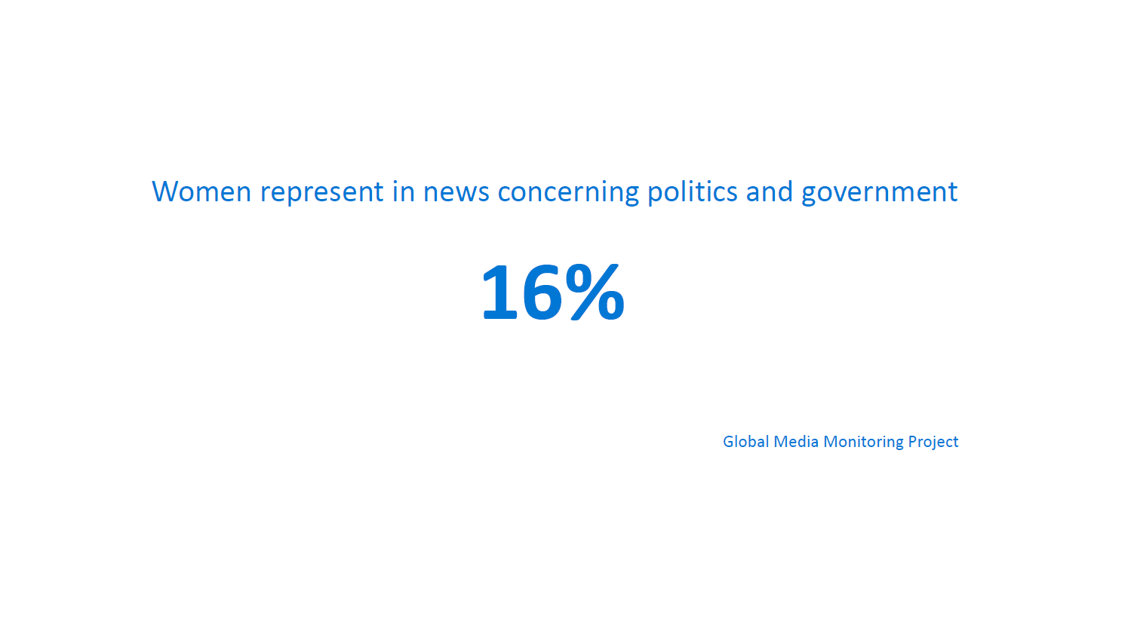
How are women represented in news concerning politics?
Introduction to Media and Information Literacy (MIL) for Mobile Teachers

Slide 68
What are the actions that schools can undertake to combat gender bias?
Inclusive Curriculum
2. Critical Media Literacy
3. Promote Inclusive Language
4. Address Bias in Classroom Dynamics
5. Support Gender and Sexuality Education
6. Professional Development
7. Diverse Role Models
8. Community Engagement
.
Introduction to Media and Information Literacy (MIL) for Mobile Teachers

Slide 69
Activity 5
Fill in the blank spaces with the correct words
-------------------------refers to the unequal treatment, stereotypes, or discrimination based on an individual's gender, often favoring one gender over another. It can manifest in various forms, such as unequal opportunities, expectations, or treatment of people based on their perceived or actual gender identity.
-----------takes place when Media portrays women in narrow and traditional roles, reinforcing stereotypes about their behavior, interests, and abilities.
----------------is manifested in underrepresenting women in media particularly in leadership roles. This lack of representation sends the message that certain roles and professions are --------------for them.
Media frequently ----------------women, reducing them to their physical appearance and sexualizing their images.
Media can depict unequal opportunities for men and women in various contexts, including work, education, and personal relationships, reinforcing the idea that these disparities are -----------------or inevitable.
Gender bias
acceptable
objectifies
Underrepresentation
Stereotyping
not suitable

Slide 70
Activity 6
Which of the below belong to the actions schools can undertake to combat gender bias? (Select all that apply)
Educators can develop curricula that challenge traditional gender roles and provide diverse perspectives on gender.
Schools could incorporate media literacy programs that teach students to critically analyze media representations of gender, pointing out stereotypes and biases.
Educators can encourage the use of inclusive language that acknowledges and respects gender diversity.
Schools can provide professional development opportunities for educators to learn about gender bias, diversity, and inclusion, enabling them to better support their students.
A good strategy is to invite diverse guest speakers and role models to share their experiences and career paths with students, breaking down stereotypes and inspiring future generations.

Slide 71
PART III
Implementation Scenarios

Slide 72
Scenario 1: Raise Awareness and Develop Competencies
Activity:
Assign students to research and select real-world examples of hate, bias, and discrimination.
They should create presentations or posters that highlight these examples.
Ask them to discuss the impact of hate speech on individuals and communities.
Ask students to propose actionable strategies for promoting peace, tolerance, and intercultural dialogue.
Final Outcome: This activity raises awareness about the issues and equips students with the competencies to address them effectively, fostering a sense of responsibility to combat hate and discrimination.
Covered Competencies:
CSE 2: Identify biased learning content and materials in the curricula, including prejudiced or discriminatory information about individuals or groups and know how to remove or add activities to discuss the biases.
CSE 4.4: Teacher supports students’ building development and maintenance of healthy interpersonal relationships, cooperation and acceptance of differences.
CSE 21: Understands the conflict, root causes and dynamics and the need for conflict transformation which includes being able to have a conversation with learners about conflict.
CSE 23: Teacher is aware of the basic nature and principles of Digital Citizenship.
Introduction to Media and Information Literacy (MIL) for Mobile Teachers

Slide 73
Scenario 2: Combating Gender Bias through “Respect Pledge”
Activity:
Discuss the gender differences, and elaborate on the diverse roles and responsibilities.
Highlight that equal treatment (equality) is a human right.
As a class, discuss and collectively agree on a "Respect Pledge" that outlines guidelines for respectful communication and behavior in the classroom.
Outline the role of females and girls and that they have equal rights and need to be treated with respect.
Emphasize the importance of listening, empathy, and constructive feedback when addressing differences.
Final Outcome: The classroom environment becomes more inclusive and respectful. Students adhere to the Respect Pledge, ensuring that everyone's perspectives and backgrounds are acknowledged and respected. This activity would also raise the awareness on girls ‘perspectives and rights.
Introduction to Media and Information Literacy (MIL) for Mobile Teachers

Slide 74
Scenario 2: Combating Gender Bias through “Respect Pledge” (Cont.)
If effectively implemented this activity would covered the following CSE competencies:
CSE 1: Can differentiate between the types of risks students may be facing in crisis and conflict settings based on gender, ethnicity, linguistic and age differences
CSE 4.2 Teacher promotes a classroom and school environment free from abuse, discrimination, exploitation and violence, including sexual and gender-based violence
CSE 4.4 Teacher supports students’ building, development and maintenance of healthy interpersonal relationships, cooperation and acceptance of differences.
CSE 4.5 Teacher demonstrates understanding of and promotes context appropriate life-skills (social-emotional well-being, respect for different abilities, health education, mine-risk awareness, self-protection from sexual and gender-based violence and exploitation etc.)
CSE 5: Teacher demonstrates awareness of ways to ensure Gender Equity, Disability and Social Inclusion in teaching and learning.
Introduction to Media and Information Literacy (MIL) for Mobile Teachers

Slide 75
Scenario 3: Deconstructing Gender Stereotypes in Media (Cont.)
Activity:
Show a series of media clips, newspaper images or songs and lyrics that contain examples of gender stereotypes or misrepresentations. Ensure the clips are age-appropriate and cover a range of contexts (e.g., commercials, TV shows, movie scenes).
After each clip, ask students to jot down their initial impressions and feelings about how women are portrayed.
On the board or flipchart, list the stereotypes and misrepresentations they identify.
Conclude the activity with a class reflection. Ask students to share what they learned and how they can apply this knowledge to critically analyze media representations in their daily lives.
Final Outcome:
This classroom activity engages students in actively identifying and critically analyzing media misrepresentations related to females and women. It encourages thoughtful discussion, reflection, and empowers students to become more discerning consumers of media.
Introduction to Media and Information Literacy (MIL) for Mobile Teachers

Slide 76
Scenario 3: Deconstructing Gender Stereotypes in Media
If effectively implemented this activity would covered the following CSE competencies:
CSE 1: Can differentiate between the types of risks students may be facing in crisis and conflict settings based on gender, ethnicity, linguistic and age differences
CSE 4.2 Teacher promotes a classroom and school environment free from abuse, discrimination, exploitation and violence, including sexual and gender-based violence
CSE 4.4 Teacher supports students’ building, development and maintenance of healthy interpersonal relationships, cooperation and acceptance of differences.
CSE 4.5 Teacher demonstrates understanding of and promotes context appropriate life-skills (social-emotional well-being, respect for different abilities, health education, mine-risk awareness, self-protection from sexual and gender-based violence and exploitation etc.)
CSE 5: Teacher demonstrates awareness of ways to ensure Gender Equity, Disability and Social Inclusion in teaching and learning
Introduction to Media and Information Literacy (MIL) for Mobile Teachers

Slide 77
Activity 7
Match activity on Coulmn A and its respective final outcome
Activity | Final Outcome
Deconstructing Gender Stereotypes in Media | Classroom environment becomes more inclusive and respectful, and students understand the importance that everyone's perspectives and backgrounds are acknowledged and respected.
Combating Gender Bias through “Respect Pledge” | Raised awareness about bias and discrimination and students are equipped with the needed competencies to address them effectively, fostering a sense of responsibility to combat hate and discrimination
Raise Awareness and Develop Competencies | Actively identifying and critically analyzing media misrepresentations related to females and women

Slide 78
Activity 8 (Self Reflection )
What activity would you suggest a teacher who is facing issues of gender-based bullying and stereotyping. Write down the activity, its specific steps, needed material (e.g. stationary, space…), required time and final outcome, as well as the CSE AoF that would be achieved through your proposed activity.

Slide 79
Activity 9: (Self Reflection )
Rate your current confidence level in supporting teachers to implement activities that focus on media misrepresentation. (poor, fair, good, very good) What would you do to enhance your understanding ?

Slide 80
Activity 10: (Self Reflection )
Out of the activities mentioned in this module, which one do you find easiest to implement? Why? What would you suggest for an effective implementation?

Slide 81
Summary
Biased communication or attitude refers to the expression of prejudice, favoritism, or unfair treatment based on preconceived notions, stereotypes, or discriminatory beliefs toward individuals or groups.
Prejudice refers to preconceived opinions or attitudes towards an individual or group, often based on stereotypes or incomplete information, that are not based on reason or actual experience.
Bias often involves the use of stereotypes, which are oversimplified and generalized beliefs about a particular group.
Discrimination is treating a person badly or unfairly on account of a personal characteristic, such as national, ethnic or social origin, gender, language, religion, disability or sexual orientation
Media misrepresentation, also known as media distortion or media bias, refers to the inaccurate or misleading portrayal of information, events, individuals, or groups by the media.
Media misrepresentation can take several forms, including selective reporting, sensationalism, confirmation bias, cherry-picking data, manipulative editing and framing.
Schools can play a great role to combat bias, discrimination and gender bias by incorporating MIL programs in the curriculum, challenge traditional gender roles and stereotypes, address biases within classroom dynamics, engage the community and provide diverse female role models.

Slide 82
References
Alagaran, J.R. II. (2017). Media and information literacy: Empower the discerning audiences. Quezon City: Abiva Publishing House Inc.
Global Media Monitoring Project, Retrieved from https://whomakesthenews.org/wp-content/uploads/who-makesthe- news/Imported/reports_2015/highlights/highlights_en.pdf
Grizzle, Alton., Carolyn Wilson, Ramon Tuazon, et. al. (2021). Media and Information Literate Citizens: Think Critically, Click Wisely. Paris: UNESCO. Retrieved from https:// unesdoc.unesco.org/ark:/48223/pf0000377068
Myat, Mon Mon (09 August 2023). Identifying Representations in Media, Information, and Digital Contents. Presentation as part of the MIL-CSE Focused e-Learning Training
Tackling discrimination. https://www.coe.int/en/web/campaign-free-to-speak-safe-to-learn/tackling-discrimination/-/asset_publisher/4a3esYbkstv9/content/improving-well-being-at-school
Tetlock, P. E., & Mitchell, G. (2009). Implicit bias and accountability systems: What must organizations do to prevent discrimination? Research in Organizational Behavior, 29, 3-38. Retrieved from The European Court of Human Rights (doi:10.1016/j.riob.2009.10.002 (researchgate.net)
Tuazon, R. Freedom of Expression and the Issues of Hate Speech, Bias, and Discrimination
Introduction to Media and Information Literacy (MIL) for Mobile Teachers

Slide 83
References
Tuazon, Ramon Guillermo R. (2022) What is MIL, MIL as a Composite Concept, and Why MIL Education. PowerPoint Presentation during the MIL Training of Trainers for Monastic and Ethnic Educators. 11 and 14 July 2022.
Tuazon, Ramon Guillermo R. (2022). The Relevance of MIL in Intercultural, Interfaith, and Interreligious Dialogues. PowerPoint Presentation during the MIL Training of Trainers for Monastic and Ethnic Educators. 20 July 2022. UNESCO Myanmar Office. (2022).
UN Committee on the Elimination of Racial Discrimination, General Recommendation No 35, 26 September 2013
UN Strategy and Plan of Action on Hate Speech, May 2019
UNESCO Myanmar Office. (2022). Introduction to Media and Information Literacy in Strengthening Pre-Service Teacher Education in Myanmar Continuous Professional Development (CPD) Information and Communication Technology (ICT). Available at https://mmteacherplatform.net/en
UNESCO Myanmar Recommendations on Religious and Culture-Sensitive Information, Education and Communication Initiatives Using the MIL Framework.
UNESCO. (2022). Addressing hate speech: educational responses

Slide 84
Thank You.

Slide 85
Media and Information Literacy through Conflict Sensitive Education (MIL-CSE)
MODULE 2.3
Media and Information Literacy (MIL) & Conflict Sensitive Education (CSE) to Combat Information Disorder

Slide 86
Media and Information Literacy through Conflict Sensitive Education (MIL-CSE)
Module 1.1: Media and Information Literacy: Definition, Importance and Implementation Scenarios
Module 1.2: Conflict Sensitive Education: Definition, Importance and Competencies
Module 1.3.: The Relationship between MIL and CSE, and Their Position within the Teacher Competency Framework
Module 2.1.: MIL & CSE to Combat Conflict Triggering Hate Speech
Module 2.2.: MIL & CSE to Address Bias, Discrimination and Misrepresentation
Module 2.3: MIL and CSE to Combat Information Disorder
Module 3.1: MIL & CSE for Intercultural and Interreligious Dialogue
Module 3.2: MIL and CSE to Foster Cyber Safety and Security

Slide 87
Learning Objectives
At the completion of this module, participants will be able to:
Describe the concept ‘Information Disorder’
Differentiate between disinformation, misinformation and malinformation
Describe the different forms within the information disorder spectrum.
Appreciate the importance of implementing MIL competencies related to information disorder in an education setting.
Apply a set of learning activities that foster critical thinking and lateral reading.

Slide 88
Module Outcomes
Raised understanding of ‘Information Disorder’
Enhanced appreciation of the importance to implement MIL competencies related to ‘information disorder’ within educational settings
Enhanced competencies to apply learning activities related to fact-checking and handling information disinformation.

Slide 89
Competencies
First Competency covered:

Slide 90
Competencies
Second Competency covered:

Slide 91
Competencies
Third Competency covered:

Slide 92
Competencies
Fourth Competency covered:

Slide 93
Competencies
Fifth Competency covered:

Slide 94
PART I
Information Disorder: Its Definition and Types

Slide 95
What is information disorder ?
INFORMATION DISORDER ecosystem has emerged to include
disinformation, misinformation, and mal-information
Disinformation
Information is false, and the person disseminating it knows it is false.
It is a deliberate, intentional lie.
Intended to cause harm – reputational, political, financial, and physical harm.
Often systematically organized, funded, and uses automated technology.
Misinformation
Information is false, but the person disseminating it believes that it is true.
Source has no manipulative or malicious intent.
Mal-information
Information is based on reality but used to inflict harm.

Slide 96
What are the different types of information disorder ?
Disinformation:
intentionally false
designed to cause harm.
is motivated by three distinct factors:
to make money;
to have political influence, either foreign or domestic; or
to cause trouble for the sake of it.
When disinformation is shared it often turns into Misinformation.
-
Misinformation:
False content shared by someone who does not realize that it is false or misleading
The sharing of misinformation is driven by socio-psychological factors.
Malinformation:
genuine information that is shared with an intent to cause harm
refers to the dissemination of false or misleading information with the intent to harm an individual, organization, or group.
Examples of malinformation include spreading false rumors, creating fake news stories, and using clickbait headlines to mislead readers.

Slide 97
How can we differentiate between misinformation, disinformation and malinformation?
Source: The Age of Information Disorder by Claire Wardle

Slide 98
What is meant by ‘information disorder spectrum ?
Information Disorder Spectrum
HIGH
New content that is 100% false, designed to deceive and to harm
When genuine information or imagery is manipulated in deceive
When genuine sources are impersonated
When genuine Content is shared with false contextual information
Misleading use of information to frame an issue or individual
When headlines, visuals or captions don’t support the content
No intention to cause harm but has potential to fool
LOW
Source: The Age of Information Disorder by Claire Wardle

Slide 99
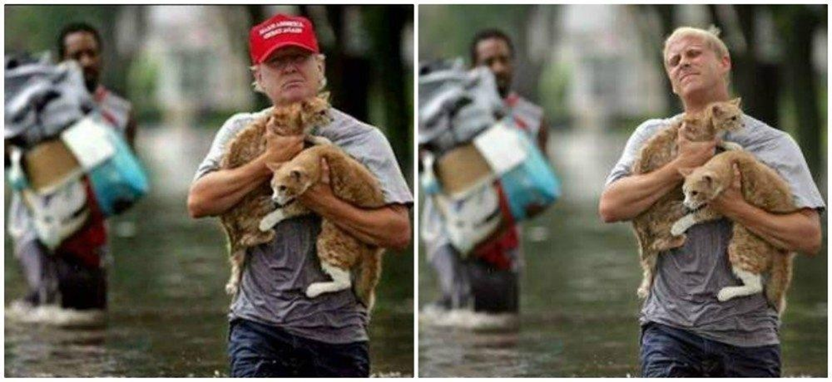
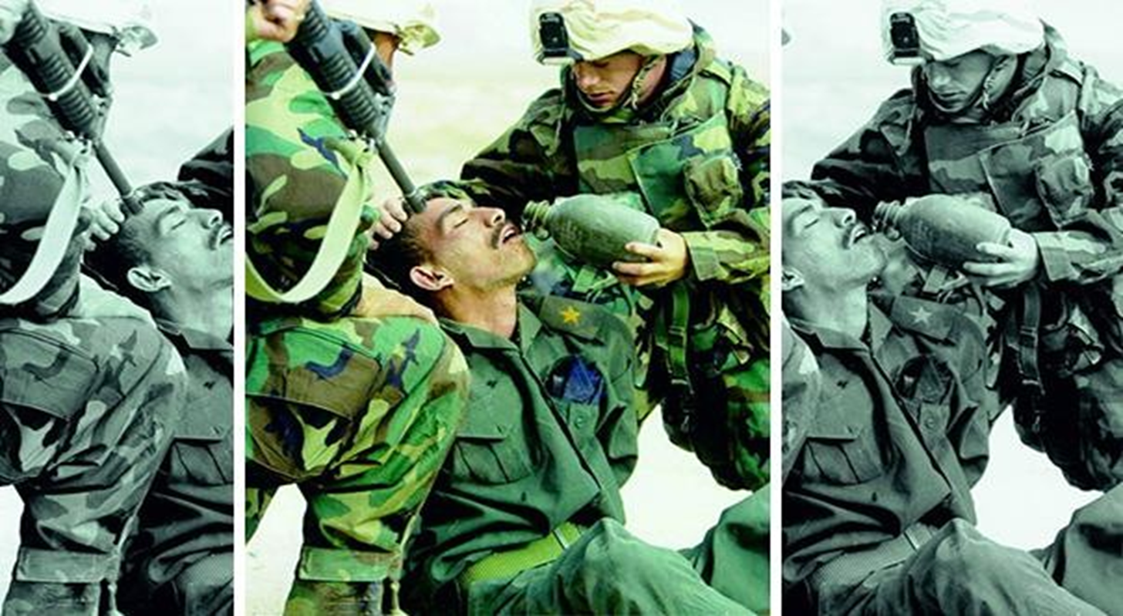
What are the seven forms of ‘information disorder’ ?
New content that is 100% false, designed to deceive and to harm. Example are fake social media accounts and deepfakes…etc.
Source: http://www.snopes.com/trump-saved-two-cats-after-hurricane-harvey/
When genuine information or imagery is manipulated in deceive. Using real images or videos to create a false narrative. Despite there being some truth, using an adaption of imagery to sensationalize a story that still misleads consumers by developing a false connection.
Source: https://www.elitereaders.com/wp-content/uploads/2015/09/funny-cropped-photos-2.jpg

Slide 100
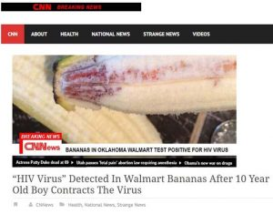
What are the seven forms of ‘information disorder’ ?
When genuine sources are impersonated. Example using the logo of a specific well-known brand next to some false content.
Fake News Alert: Eight Children Contract HIV From Walmart Bananas - POZ
When genuine Content is shared with false contextual information.
LOW
FALSE: 'DepEd announces Grade 13' (rappler.com)

Slide 101
What are the seven forms of ‘information disorder’ ?
Misleading use of information to frame an issue or individual. Selecting a segment from a quotation or data set to support or highlight a particular claim or perspective. Also, ignoring how data set was created. It can also refer to cropping a photo to pursue an agenda.
THIS WEEK IN FAKE NEWS: Duterte DID NOT sign any ‘no homework policy’ - VERA Files

Slide 102
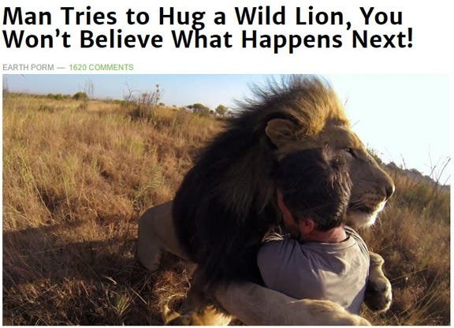
What is meant by the ‘information disorder spectrum ?
You won’t believe how these 9 shocking clickbaits work! (number 8 is a killer!) | by Ashuta | The Zerone | Medium
The use of sensational headline (or illustrations) to attract attention of readers but headline is disconnected from or not related to the content.
“Clickbait” – emotionally arousing and sensational headlines to lure visitors to websites.
55 Times ‘Stop Clickbait’ Hilariously Summarized Crappy Articles And Saved You A Click | Bored Panda

Slide 103
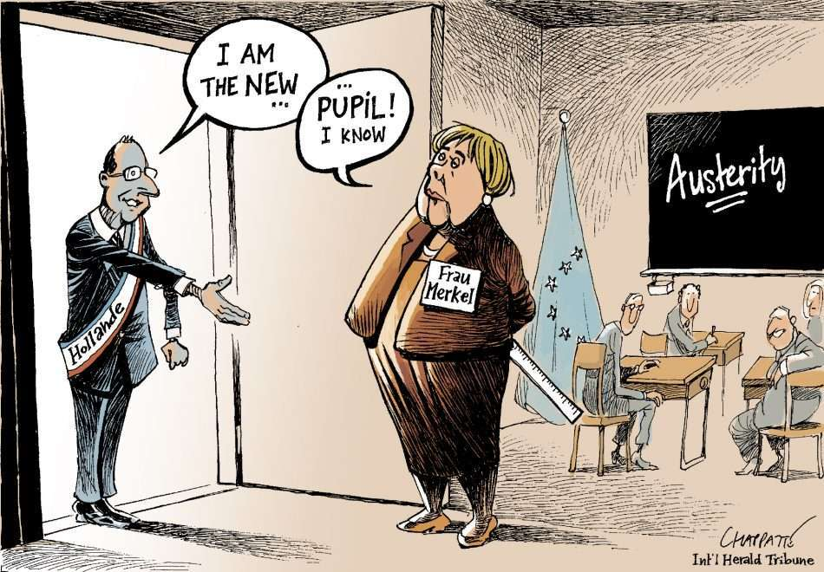
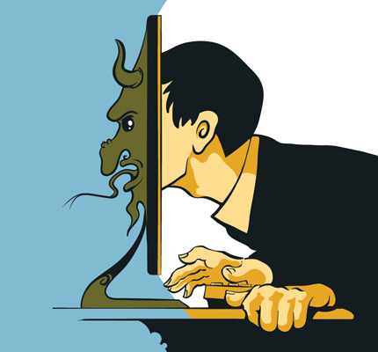
What are the seven forms of ‘information disorder’ ?
No intention to cause harm but has potential to fool
Use of sarcastic statements with intent to mock or ridicule or make fun of individuals, events, issues, etc.
A parody is a form of humor that spoofs — or satirizes — something using the same form. For example, shows like "Saturday Night Live" and "The Daily Show" parody newscasts by doing fake newscasts that look like the real thing. Comedians and comedy writers love to parody the President.
IO1-G. Satire, parody, memes: examples (defacto.space)
Trolling for Social Change? How John Oliver Uses Satire and Parody on Last Week Tonight | National Communication Association (natcom.org)

Slide 104
“Democracy cannot succeed unless those who express their choice are prepared to choose wisely. The real safeguard of democracy, therefore, is education.
”
Franklin D. Roosevelt

Slide 105
Activity 1
Match type or form of information disorder on Coulmn A to its definition in Colum B
Term | Definition
Disinformation | false content but the person sharing doesn’t realize that it is false or misleading
Misinformation | is content that is intentionally false and designed to cause harm. It is motivated by three distinct factors: to make money; to have political influence, either foreign or domestic; or to cause trouble for the sake of it.
Misleading Content | content created with the intent to mock or ridicule or make fun of individuals, events or issues
Satire of Parody | Misleading use of information to frame an issue or individual by selecting a segment from a quotation or data set to support a particular claim or by ignoring how data set was created.
Clickbait | New content that is 100% false, designed to deceive and to harm
Fabricated Content | emotionally arousing and sensational headlines to lure visitors to websites.

Slide 106
Activity 2
Q2: Select from the below all correct statements
Disinformation is fabricated or deliberately manipulated audio or visual content. It is intentionally created and an example of that are rumors.
Disinformation, malinformation and misinformation are three terms that can be used interchangeably as they are all the same and all part of the bigger term ‘ information disorder’ .
False connection and clickbait are the use of sensational headline (or illustrations) to attract attention of readers but headline is disconnected from or not related to the content.
Imposter Content refers to when genuine sources are impersonated. Example using the logo of a specific well-known brand next to some false content.
Disinformation is the creation of content that intended to cause harm, e.g. reputational, political, financial, and physical harm. This type is often systematically organized, funded, and uses automated technology.
Manipulated content refers to the usage of real images or videos to create a false narrative. Despite there being some truth, using an adaption of imagery to sensationalize a story that still misleads consumers by developing a false connection.

Slide 107
PART II
Implementing Conflict Sensitive Education Areas of Focus
to Combat Information Disorder

Slide 108
Why is teaching about information disorder so important?
1. Critical Thinking Skills: Education about information disorders encourages children to question what they see and read, rather than accepting information at face value. This empowers them to make informed judgments about the accuracy and credibility of sources.
2. Safe Internet Navigation: Teaching children about information disorders equips them with the skills to navigate the internet safely and responsibly. They learn to distinguish between reliable sources and unreliable ones, reducing their susceptibility to false or misleading information.
3. Critical Media Use: Children learn how media outlets can shape and present information to influence opinions. This knowledge enables them to consume media critically and discern the underlying biases or agendas.
4. Responsible Citizenship: In a democratic society, informed citizens are crucial. Teaching children about information disorders prepares them to participate in civic life responsibly. They can make informed decisions when voting, engaging in discussions, or advocating for causes.

Slide 109
Why is teaching about information disorder so important? (Cont.)
5. Emotional Well-being: Children who are aware of information disorders are better equipped to handle the emotional impact of misinformation and disinformation. They can also help peers who may be affected.
6. Combating the Spread: Children can play a role in promoting a more truthful and reliable digital environment by reporting false information and raising awareness among their peers.
7. Lifelong Skills: The ability to assess information critically and identify information disorders is a valuable skill that children can carry with them into adulthood. It will serve them well in their academic pursuits, careers, and personal lives.
Teaching children about information disorders is essential for their personal development, online safety, and their role as responsible citizens in an information-rich society. . It empowers them to navigate the digital world with confidence and discernment, making them less vulnerable to the negative consequences of misinformation and disinformation.

Slide 110
Scenario 1: Teaching about Clickbait
Learning Objective: To teach students how to recognize clickbait headlines, understand their purpose, and analyze their impact.
Competencies covered:
Materials Needed:
Internet-connected devices (computers or tablets) or some newspapers or magazines
A list of clickbait headlines (pre-selected by the teacher or sourced from the internet)

Slide 111
Scenario 1: Teaching about Clickbait (cont.)
Activity Steps:
Introduction (20 minutes):
Begin by discussing what headlines are and why they are important in news articles, blog posts, and social media.
Explain that some headlines are designed to grab attention and generate clicks, even if the content doesn't match the promise of the headline. These are known as "clickbait" headlines.
Define clickbait for the students. : “Clickbaits are headlines that use sensational language or promises to entice people to click on a link but often do not deliver meaningful or accurate content.”
2. Identify Clickbait (15 minutes):
Provide a list of pre-selected clickbait headlines (or ask students to find their own examples) and ask students to identify which headlines they believe are clickbait.
Encourage them to consider what elements make these headlines particularly attention-grabbing.

Slide 112
Scenario 1: Teaching about Clickbait (cont.)
Activity Steps:
3. Discussion (15 minutes):
Facilitate a class discussion based on their observations.
Discuss the common tactics used in clickbait headlines, such as exaggeration, emotional language, curiosity gaps, or promising unrealistic outcomes.
Emphasize that the purpose of clickbait is often to generate clicks and views rather than to provide informative or valuable content.
4. Impact Analysis (20 minutes):
Divide the class into small groups and provide each group with one or more clickbait headlines. Instruct them to:
Analyze how well the content matches the promises made in the headlines.
Discuss the potential consequences of clickbait, such as misinformation, frustration, or disappointment.
5. Group Presentations (15 minutes):
Have each group share their findings with the class. T
hey can present their analysis of the headlines, including whether the content lived up to the promises and how they felt about the experience.
Tell your students:
Be cautious! Many fake reports are designed to draw emotions. Watch out for ALL-CAPS HEADLINES and the use of excessive punctuations. If a “news report” you saw on your Facebook or Twitter feed makes you angry, it’s probably designed that way. Don’t share it straight away without verifying.

Slide 113
Scenario 1: Teaching about Clickbait (cont.)
Activity Steps:
6. Reflection (10 minutes):
Conclude the activity with a reflection discussion:
Ask students how they can apply what they've learned about clickbait to their online browsing or their news reading .
Encourage them to share strategies for recognizing and avoiding clickbait.
Discuss the importance of critical thinking when consuming online content.
7. Homework Assignment (optional):
As a follow-up assignment, you can ask students to find and bring examples of non-clickbait headlines that deliver accurate and valuable content.
Final Outcome:
This activity not only helps students understand the concept of clickbait but also equips them with valuable skills to critically evaluate online information and make informed decisions about what to click on and engage with.

Slide 114
Scenario 2: Teaching about fabricated/manipulated content
Learning Objective: To teach students how to recognize identify false content by critically analyzing what is shared or provided to them.
Competencies covered:
Materials Needed:
Newspapers, magazine or a computer device that is connected to the internet.

Slide 115
Scenario 2: Teaching about fabricated/manipulated content(cont.)
Activity Steps:
Introduction (10 minutes):
Begin by discussing what the concept of ‘information disorder’ and describe some examples of manipulated content and fabricated news.
Explain that there are techniques if implemented, they can figure out if a news or content (esp. online content ) is fake or accurate.
Explain ‘signs’ of fakeness or fabrication include:
→No ‘About’ page: Many websites peddling false information aggregate content from other
websites. Check their “About” pages. Legitimate news sites provide information about their organization; bogus news sites mostly don’t.
→ Bad Grammer: Many fake reports are badly written with lots of grammatical mistakes.
→ Suspicious URLs: Tell your students always to go beyond headline and to check the URL. Does
it read like the URL of a trusted news organization? Take a second look! Impostor sites steal
brands by changing one character and adding words like .channel or –tv in the domain. Examples
of bogus websites: Aljazeera-tv.com, gma-tv.com,
→ NO BYLINES: If there’s no name attached to a report circulating online, it could
be fake. Byline equals accountability, a core principle in journalism.

Slide 116
Scenario 2: Teaching about fabricated/manipulated content(cont.)
2. Identify fabricated / manipulated content (20 min)
Ask your students to browse the internet, or read the newspapers you provided them, to try to find some of the signs you have just mentioned.
This might be a homework, as it will consume at least 20 min.
3. Discussion (15 minutes):
Facilitate a class discussion based on their findings
Discuss the common tactics used in to figure out which of the provided content is fabricated or manipulated.
Emphasize that the purpose of such misinformation is often to generate manipulate and deceive the audience or readers.
Tell your students:
Identifying fabricated content means to look for signs. Those include:
-Bad grammar
-Suspicious URL
-No name of porter or news editor.
-No About / About US page.

Slide 117
Scenario 2: Teaching about fabricated/manipulated content (cont.)
Activity Steps:
4. Reflection (10 minutes):
Conclude the activity with a reflection discussion:
Ask students how they can apply acquired techniques in their future news reading (whether off-or online)
Encourage them to share strategies for recognizing and avoiding being deceived.
Discuss the importance of critical thinking when consuming online content.
7. Homework Assignment (optional):
As a follow-up assignment, you can ask students to find and bring examples of more fabricated content
Final Outcome:
This activity not only helps students understand the concept of identifying fabricated content, but also equips them with valuable skills to critically evaluate online information and make informed decisions about what to believe, consume, share and what not.

Slide 118
Scenario 3: Teaching about fact-checking
Learning Objective: To teach students how to recognize identify false content by critically analyzing what is shared or provided to them.
Competencies covered:
Materials Needed:
Newspapers, magazine or a computer device that is connected to the internet.

Slide 119
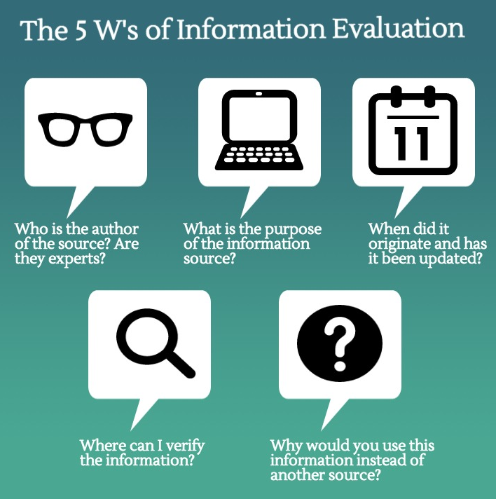
Scenario 3: Teaching about fact-checking (cont.)
Activity Steps:
Introduction (20 minutes):
Begin by discussing the 5 W strategy of fact-checking news and content.
Introduce the concept of “Lateral reading” which is the act of verifying what you’re reading as you’re reading it” (Terry Heick as cited by News Literacy Project)
Introduce the concepts of safe online browsing:
Open a new tab in your browser when you come across an unfamiliar online source.
Search the name of the unfamiliar source.
Check what trustworthy sites say about it.
If the source seems untrustworthy, don't waste your time on it. Find a better source.

Slide 120
Scenario 3: Teaching about fact-checking (cont.)
2. Apply the three mentioned strategies(20 min)
Ask your students to browse the internet, or read the newspapers you provided them with.
Select one article and discuss the 5 Ws.
Let them come up with the answer to the five questions.
If they are not so sure ask them to use the safe online browsing technique to check the trustworthiness of the agency or the author.
3. Impact analysis (15 minutes):
Facilitate a class discussion based on their findings
Discuss the consequences and impact of consuming news or content without conducting any fact-checking.
Ask them to come up with fictious scenarios about the negative impact of a group or population consuming fabricated and unauthentic content without conducitng the appropriate fact checking.
Final Outcome:
This activity not only helps students understand the concept of fact-checking and its techniques, but also equips them with valuable skills to critically evaluate online information and make informed decisions about what to believe, consume, share and what not.

Slide 121
Activity 3:
True of False
Statements | True | False
a) Information disorder is an ecosystem that includes misinformation, disinformation and mal-information.
b) Clickbait headlines are designed to entertain readers. Therefore, they are by no means harmful and should be encouraged.
c) Asking students to discuss news and content that is inaccurate and provide them with techniques to search for signs of inaccuracy or fakeness are good MIL activities.
d) Malinformation is based on reality and there is no intent to harm.
e) When information is false and the one who created it knows it is false, this is called disinformation.
f) Conducting ‘Impact Analysis’ activities are good techniques to develop students’ critical thinking skills
g) “Lateral reading” is the act of verifying what you’re reading as you’re reading it.
h) Content with excessive grammatical mistakes and a suspicious creator definitely accurate and professional. We should rely on it.

Slide 122
Activity 4
Select from the below all reasons justifying the importance of teaching children about information disorder.
Education about information disorders helps children develop critical thinking skills. It encourages them to question what they see and read.
In today's digital age, children are exposed to a vast amount of information online. Teaching them about information disorders equips them with the skills to navigate the internet safely and responsibly. They learn to distinguish between reliable sources and unreliable ones, reducing their susceptibility to false or misleading information.
Children will learn how media outlets can shape and present information to influence opinions. This knowledge enables them to consume media critically and discern the underlying biases or agendas.
Children who are aware of information disorders are better equipped to handle the emotional impact of misinformation and disinformation. They can also help peers who may be affected by it.
Information disorders often spread through social media and other online platforms. Educating children about these issues includes teaching them how to stay safe online, avoid online scams, and protect their personal information.

Slide 123
Activity 5: (Self Reflection )
Rate your current confidence level in supporting teachers to implement activities that focus on fact-checking. (Poor, fair, good, very good) What would you do to enhance your understanding ?

Slide 124
Activity 6: (Self Reflection )
What activity would you suggest a teacher who is complaining that his students just believe any rumor or inaccurate information provided to them. Write the activity that you would recommend him. Do not forget to mention the exact activity steps, needed requirements, final outcome, as well as the CSE AoF that would be achieved through your proposed activity.

Slide 125
Activity 7: (Self Reflection )
Out of the activities mentioned in this module, which one do you find easiest to implement? Why? What would you suggest for an effective implementation?

Slide 126
Summary
Information disorder ecosystem has emerged to include disinformation, misinformation, and mal-information.
Disinformation is content that is intentionally false and designed to cause harm. When disinformation is shared it often turns into misinformation.
Often a piece of disinformation is picked up by someone who doesn’t realise it’s false, and shares it with their networks, believing that they are helping. This is called misinformation.
Malinformation on the other hand is deliberate publication of information that can be harmful to individuals or organizations.
There is a wide spectrum within the information disorder, which includes seven forms. Those differ in terms of falseness and the intention to cause harm. Fabricated and manipulated content are very harmful and dangerous in terms of their negative impact. The least ones in terms of negative consequences are false connection, such as clickbait and satire.
Teaching children about information disorders develops their critical thinking skills, MIL competencies, fosters responsible citizenship, nurtures their emotional well-being, and ensures a responsible, ethical and safe access, use and creation of media and information content.

Slide 127
References
AFP Fact Check. (2021, March 1). Doctored news graphic falsely claims Filipino official advised giving China's Sinovac vaccine to poor people. https://factcheck.afp.com/doctored-news-graphic-falsely-claims-filipino-official-advised-giving-chinas-sinovac-vaccine-poor
Alagaran, J.R. II. (2017). Media and information literacy: Empower the discerning audiences. Quezon City: Abiva Publishing House Inc.
Alagaran, J.R. II (2023). Basic Skills in Discerning Disinformation and Misinformation. {Presentation for MTTs on August 16, 2023)
Bored Panda. 55 Times ‘Stop Clickbait’ Hilariously Summarized Crappy Articles And Saved You A Click | Bored Panda
Caufield, M. (2019, June 19). SIFT (The Four Moves). https://hapgood.us/2019/06/19/sift-the-four-moves/
Civic Online Reasoning. (n.d.). Teaching lateral reading. https://cor.stanford.edu/curriculum/collections/teaching-lateral-reading/
COMPACT Education Group. (March 2020). Guide to Conspiracy Theories. European Cooperation in Science and Technology
Dean, James (2010). Mighty Optical Illustions. Retrieved from Media Manipulation Illusion Example (moillusions.com)
Introduction to Media and Information Literacy (MIL) for Mobile Teachers

Slide 128
References
Defacto Space. https://defacto.space/io1-a/examples-satire-parody-memes/
Ireton, Cherilyn & Posetti, Julie (2018). Journalism, ‘Fake News’ & Disinformation: Handbook for Journalism Education and Training. Paris: UNESCO
Lopez, Ann Lourdes C. (2020). News Literacy and Citizenship in the Information Disorder. PowerPoint Presentation for Developing Champion Teachers in News Literacy. Asian Institute of Journalism and Communication
Medium You won’t believe how these 9 shocking clickbaits work! (number 8 is a killer!) | by Ashuta | The Zerone | Medium
National Communication Association. https://www.natcom.org/communication-currents/trolling-social-change-how-john-oliver-uses-satire-and-parody-last-week
Paraan, Rowena C. (AIJC, 2020). Exploring Information Neighborhoods & Fact-Checking. PowerPoint Presentation for Developing Champion Teachers in News Literacy. Asian Institute of Journalism and Communication
Rappler.com (2020). FALSE: DepED Announces Grade 13. Retrieved from FALSE: 'DepEd announces Grade 13' (rappler.com)
Introduction to Media and Information Literacy (MIL) for Mobile Teachers

Slide 129
References
POZ. (2020) Fake News Alert: Eight Children Contract HIV From Walmart Bananas Retrieved from Fake News Alert: Eight Children Contract HIV From Walmart Bananas - POZ
RISE (2022). Teacher Competency Framework
Silverman, Craig. (2020). Verification Handbook for Disinformation and Media Manipulation.#ThinkBeforeSharing - Stop the spread of conspiracy theorieshttps://en.unesco.org/themes/gced/thinkbeforesharing?fbclid=IwAR3FgRVTCkL_evrFNNGUYpsmhPLNgZb9nB-yMiimioW48TX91p8a_2g75d0
Snopes. (2017). Did President Trump save two cats after Harricane Harvey? Retrieved from Did President Trump Save Two Cats After Hurricane Harvey? | Snopes.com
Tuazon, Ramon, Understanding and Addressing Information Disorder, PowerPoint presentation
The Zerone. You won’t believe how these 9 shocking clickbaits work! (number 8 is a killer!) | by Ashuta | The Zerone | Medium
University of Michigan. (n.d.). Evaluating sources. https://umich.instructure.com/courses/83460/pages/step-5-evaluating-sources
Introduction to Media and Information Literacy (MIL) for Mobile Teachers

Slide 130
References
UNESCO. (n.d.) Media and information literacy. https://en.unesco.org/themes/media-and-information-literacy
VERAfied: A DIY Guide to Fact-Checking and Fighting Misinformation and Disinformation, VeraFiles:2021
VERAFied: THIS WEEK IN FAKE NEWS: Duterte DID NOT sign any ‘no homework policy’ - VERA Files
Wardle, Claire. (2020). The Age of Disinformation Order in Verification Handbook for Disinformation and Media Manipulation.
Wardle, C. (n.d.). The Age of Information Disorder. https://datajournalism.com/read/handbook/verification-3/investigating-disinformation-and-media-manipulation/the-age-of-information-disorder
Wardle, C. (2020, September 22). Understanding Information disorder. https://firstdraftnews.org/long-form-article/understanding-information-disorder/
Introduction to Media and Information Literacy (MIL) for Mobile Teachers

Slide 131
Thank You.

